Slide 1
RA Didactics- Introduction to R Week 2
Jon Clucas and Bonhwang Koo

Slide 2
Previously on RA Didactics
Introduction; installation; RStudio IDE interface
Data Types and Structures
Basic Operations
Manipulating Strings
`print` function
Calling a vector (e.g., x ) on its own is equivalent to calling the print function with that vector as the function’s first argument (e.g., print(x) ).
You only need to call the print function explicitly if you want to pass the function additional parameters, (e.g., print(x, quote = FALSE) ), or if you are calling print within another call.

Slide 3
This Week’s Topics
File Handling
More Operations
Boolean Logic and Conditional Statements
Loops

Slide 4
File Handling
getwd() - Returns the filepath of the current, or working directory
setwd(“/Users/username/Desktop”) - Sets the working directory to the filepath
read.csv(file = “filename.csv”) - Creates a dataframe from the contents of a .csv file
write.csv(dataframe, file = “filename.csv”) - Writes a .csv file from the contents of a dataframe
file.path() - similar to the paste function; concatenates folders in a file path and automatically separates each string by a “/”
list.files(“/Users/username/Desktop”) - returns a vectors containing strings of all the files and folders in a filepath. If no filepath is specified, the default is the current working directory (getwd())

Slide 5
More operations- Descriptive
$ - Used to access an individual column of a dataframe
mean()
median()
quantile()- Divides a vector into quantiles (i.e. 0th, 25th, 50th/median, 75th, and 100th percentiles)
min()
max()
var() - variance
sort()
summary()
min, max, mean, median, and quantiles
Will summarize each column in a 2-D data frame

Slide 6
Operations cont.
All of these functions (except sort) accept the na.rm (NaN remove) argument, which is important if your dataset contains null (nonexistent) values. If you want to ignore them, set na.rm = TRUE (otherwise, the function defaults to na.rm = FALSE)

Slide 7
Operating Vectors
Vectors can work under the same operators as single variables- the operation is carried out on all elements
> c(1,2,3,4) + c(4,3,2,1)
[1] 5 5 5 5
> c(1,2,3,4) * 4
[1] 4 8 12 16

Slide 8
Boolean Logic
A form of algebra in which all values are reduced to TRUE or FALSE
Fits into binary numbering- bits are either 1 (TRUE) or 0 (FALSE)

Slide 9
Boolean Operators
NOT (!) - Flips the value of a variable
AND (&, &&) - P & Q returns TRUE when both P and Q are TRUE
OR (|, ||) - P | Q returns TRUE when either P or Q or both are TRUE
Note- The long form || and && evaluate only the first element of a vector. Short form | and & evaluate each element in a vector.
| and & are more common
xor(x, y) - Exclusive OR; xor(P, Q) returns TRUE only when either P or Q, but not both, is true

Slide 10
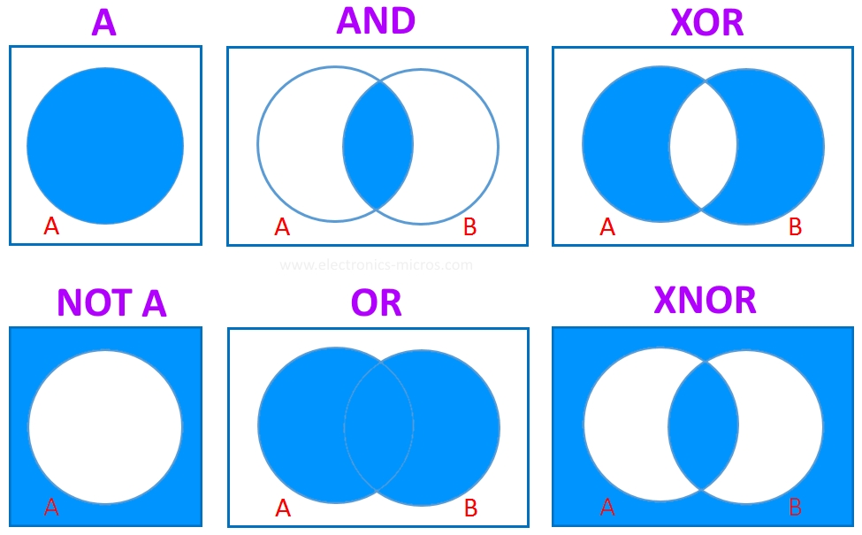
Venn Diagram Representation

Slide 11
Boolean Operators
P | Q | P & Q | P | Q | !P | !Q | xor(P, Q) | !(!P & Q)
F | F | F | F | T | T | F | ?
F | T | F | T | T | F | T | ?
T | F | F | T | F | T | T | ?
T | T | T | T | F | F | F | ?

Slide 12
Boolean Operators
!P | Q | !P & Q | !(!P & Q)
T | F | F | T
T | T | T | F
F | F | F | T
F | T | F | T

Slide 13
Other operations
==, <, >, <=, >=
all()
Returns TRUE if all values in a logical vector are true

Slide 14
Boolean logic with vectors
In R, we can filter elements from a vector by passing boolean vectors through bracket statements:
For example:
> x <- c(1,4,7,NA,12,19,15,NA,20)
> x_is_NA <- is.na(x)
[1] FALSE FALSE FALSE TRUE FALSE FALSE FALSE TRUE FALSE
> x_no_NA <- x[!x_is_NA]
[1] 1 4 7 12 19 15 20

Slide 15
x | 1 | 4 | 7 | NA | 12 | 19 | 15 | NA | 20
x_is_NA | FALSE | FALSE | FALSE | TRUE | FALSE | FALSE | FALSE | TRUE | FALSE
!x_is_NA | TRUE | TRUE | TRUE | FALSE | TRUE | TRUE | TRUE | FALSE | TRUE
x[!x_is_NA] | 1 | 4 | 7 | -- | 12 | 19 | 15 | -- | 20

Slide 16
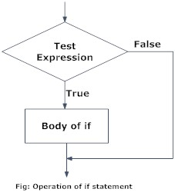
Conditional Statements
if (test_expression) {
statement
}
If test_expression is TRUE, then the statement is executed.
If test_expression is FALSE, then nothing happens.

Slide 17
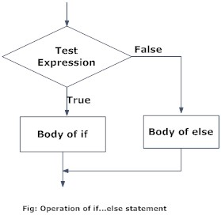
If/Else
if (test_expression) {
statement1
} else {
statement2
}
The “else” statement is evaluated only when test_expression is FALSE.
In R, the else statement must be written on the same line as the closing bracket of the “if” statement

Slide 18
Else-if
if (test_expression1) {
statement1
} else if (test_expression2) {
statement2
} else {
statement3
}
We can nest as many else if statements as necessary
Only one statement will be executed

Slide 19
Loops
A sequence of instructions that is repeated until a set of conditions are met
For
Fixed iterations, based on a set sequence
Most common
While
Iterates on the basis of a condition
Repeat
Similar to a while loop, except that it iterates at least once
Ensure all loops have a breaking condition. Otherwise the loops will run forever.

Slide 20
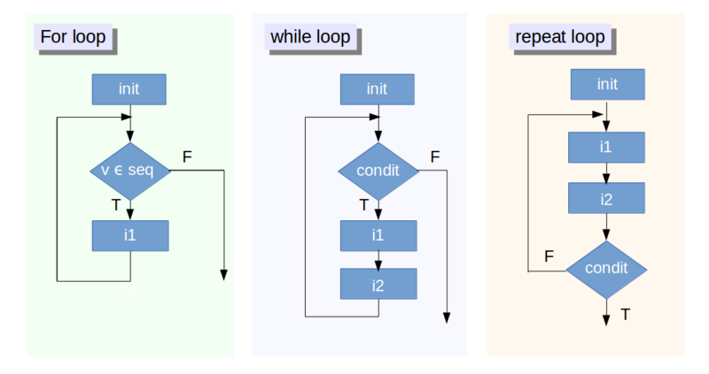
Loops Visualized
Is the current iteration part of the sequence?
Notes:
https://www.datacamp.com/community/tutorials/tutorial-on-loops-in-r#gs.3ru8P=E

Slide 21
How to exit a loop
break - exit the loop
next - discontinue an iteration and proceed with the next one

Slide 22
Some Useful Websites
https://www.programiz.com/r-programming/if-else-statement (conditional statements)
https://www.datacamp.com/community/tutorials/tutorial-on-loops-in-r#gs.3ru8P=E (loops)

